Slide 1
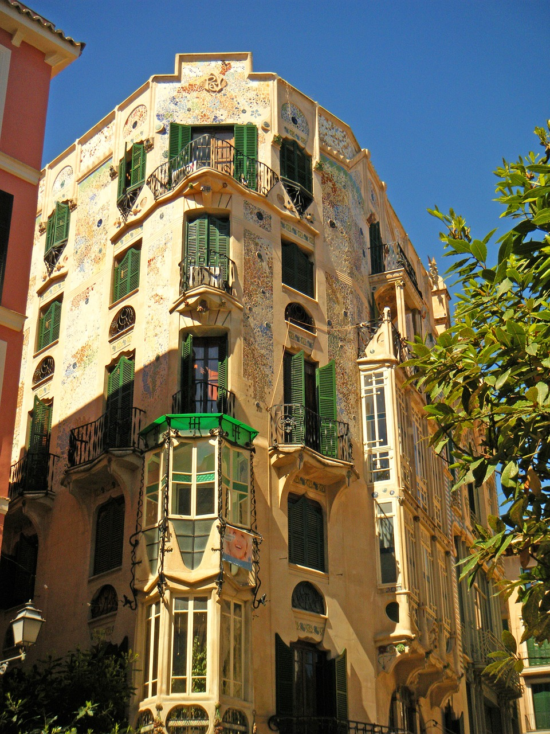
6th Phonetics and Phonology in Europe
University of the Balearic Islands
Palma, 25-27 June 2025

Slide 2
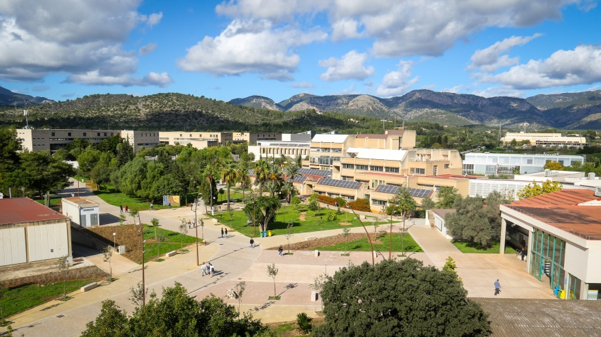
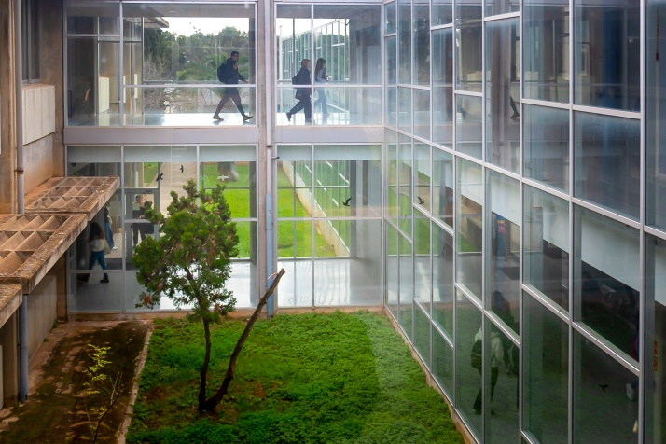
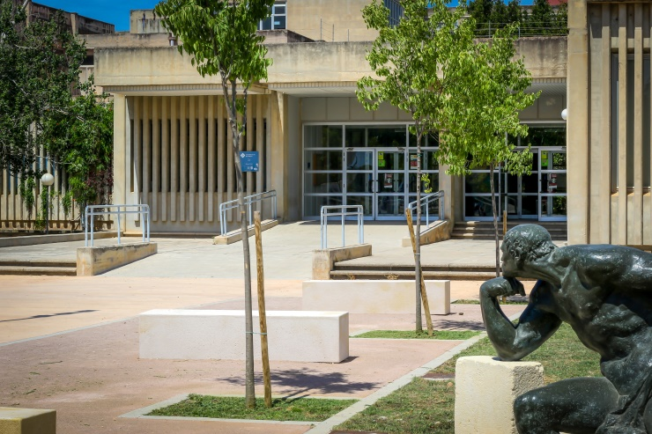
Venue
UIB main Campus (7 km from the center of Palma)
Bus and underground service with good timetables and frequencies
Mallorca’s international airport is 15 minutes from the UIB campus
©A. Costa/UIB

Slide 3
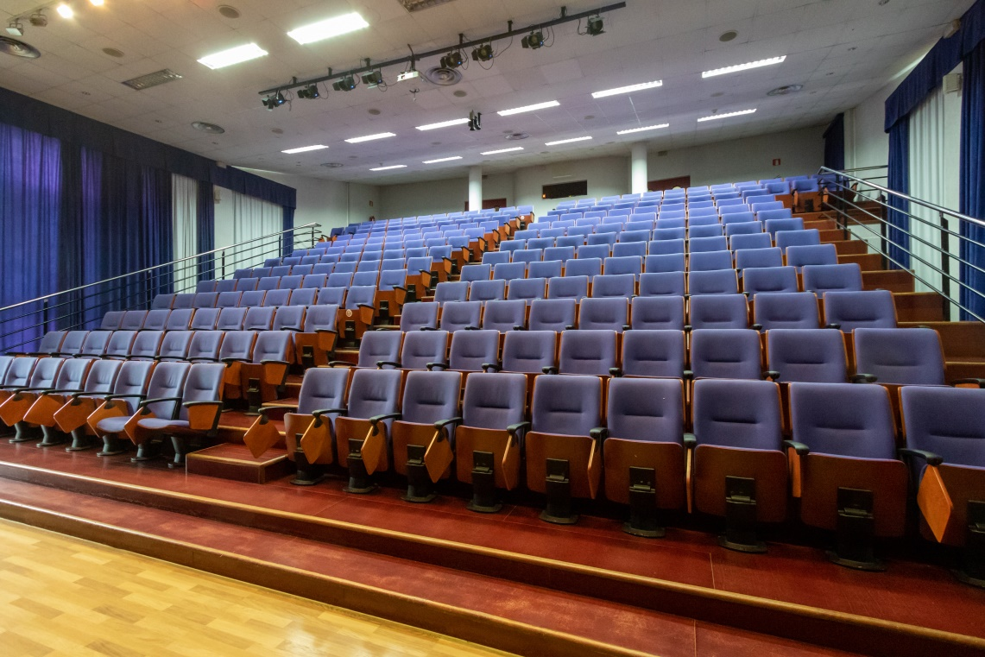
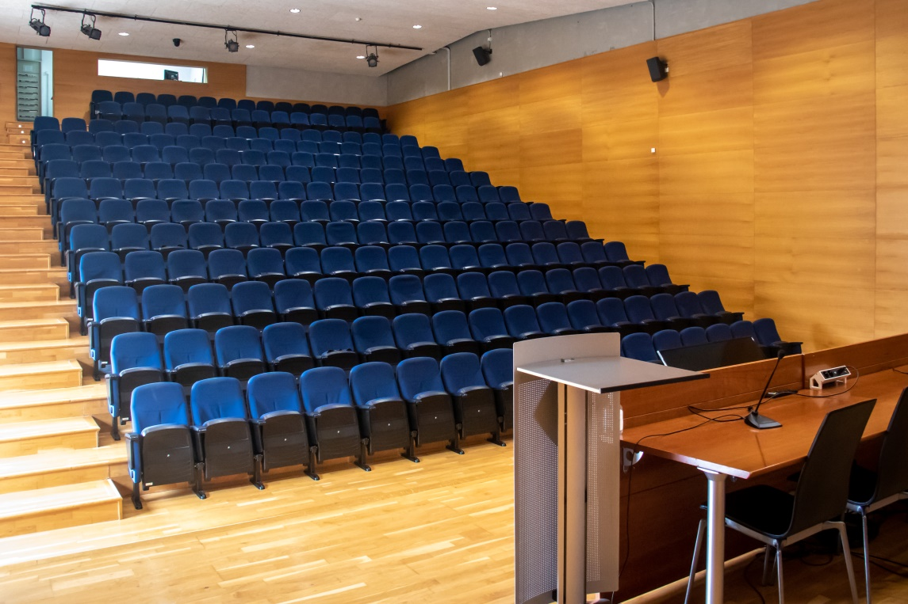
Conference Rooms
Guillem Cifre building (Faculty of Education). Capacity for 260 attendees
Jovellanos building (Faculty of Law and Economics). Capacity for 216 attendees
©A. Costa/UIB

Slide 4
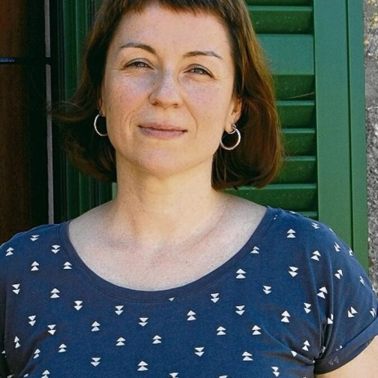
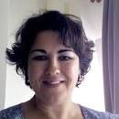
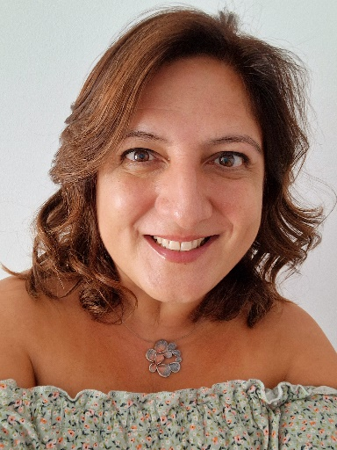
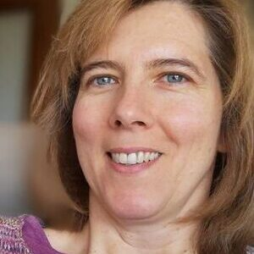
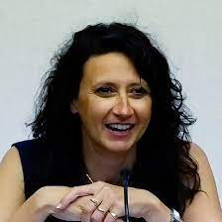
Some of your hosts…
Maria del Mar Vanrell
Ariadna Benet
Lucrècia Rallo
Susana Cortés
Eva Aguilar

Slide 5
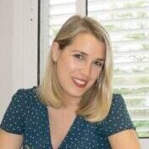
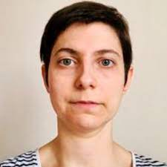
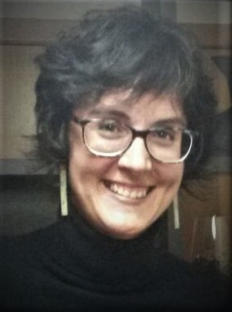
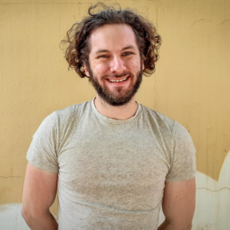
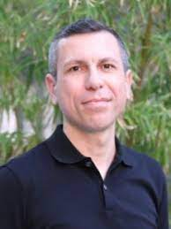
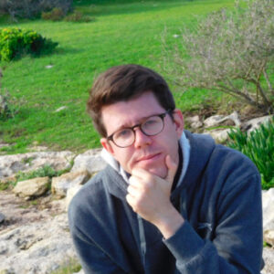
Some of your hosts…
Isabel Crespí
Melania S. Masià
Assumpció Rost
Christopher W. Little
Miquel Simonet
Francesc Torres-Tamarit

Slide 6
Conference Theme: Phonetics and Phonology in a Multilingual World
Early Language Acquisition
L2 Speech Learning, Development and Processing
Sound Change, Language Contact
Phonetic and Phonological Accomodation, Language Attitudes and Identity
Migration and Language: Space, Time, Sociocultural Factors
Youth Language
Phonological and Reading Development
Sociolinguistic and Pedagogical Aspects of Multilingualism
Minority/Endangered Languages
Sign Languages
Phonetics and Phonology across Species
…

Slide 7
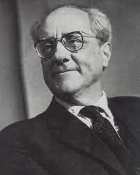
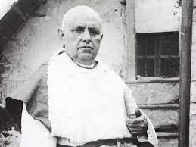
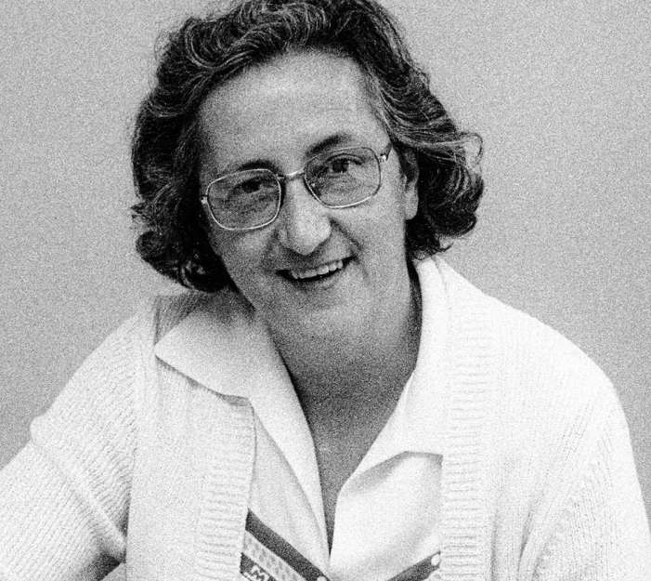
Prominent figures in the field of philology in Mallorca
Antoni Maria Alcover, Francesc de Borja Moll, and Aina Moll have contributed significantly to the study and understanding of Catalan.
They were responsible for enabling the creation of the Diccionari Alcover-Moll.
Francesc de Borja Moll and Aina Moll authored the first instructional manuals for learning French and Spanish.
Aina Moll participated in cultural activism, supporting events and campaigns for Catalan language normalization.

Slide 8
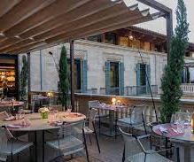
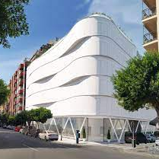
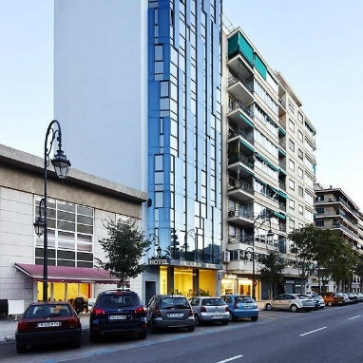
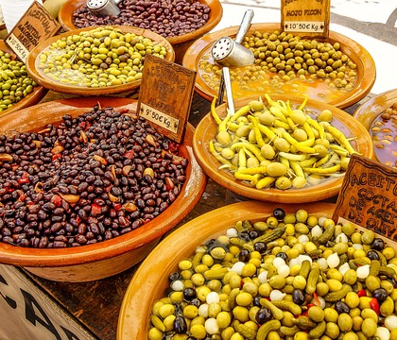
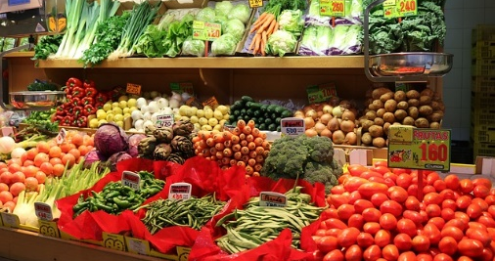
Accommodation and restaurants
Palma presents a diverse selection of lodging choices that accommodate various budgets and cater to individual preferences.
The city also offers an irresistible array of bars, restaurants, and municipal markets that captivate the senses with vibrant colors, and enthralling atmosphere.

Slide 9
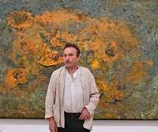
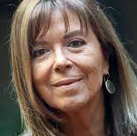
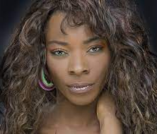
Mallorca: a historical cultural hub
Notable individuals from Mallorca include the artist Miquel Barceló, Concha Buika, singer and composer Maria del Mar Bonet and the film director Agustí Villaronga, among many others.
Frequent visitors were the musician Frederic Chopin and his wife George Sand, writers Robert Graves and Agatha Christie and celebrities such as Michael Douglas and Princess Grace of Monaco (the typical Mallorcan cookies “quelitas” were named after her!).

Slide 10
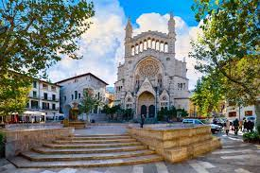
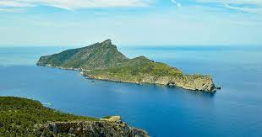
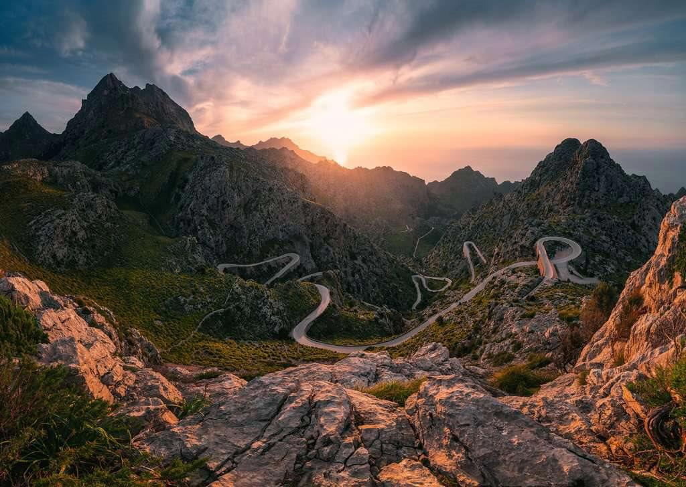
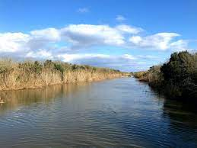
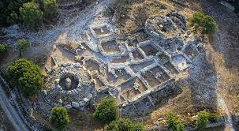
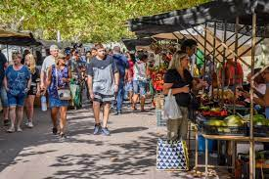
Excursions and spare time activities
Sóller, a (linguistic) island in an island
sa Dragonera, a significant landmark affirming the environmentalist movement in Mallorca
Serra de Tramuntana (hiking trails, UNESCO World Heritage Site)
s’Albufera is perfect for bird watching
Son Fornés, talaiots as the most mysterious monuments in the Balearic Islands
Santa Maria del Camí market, a place to find a bit of everything

Slide 11
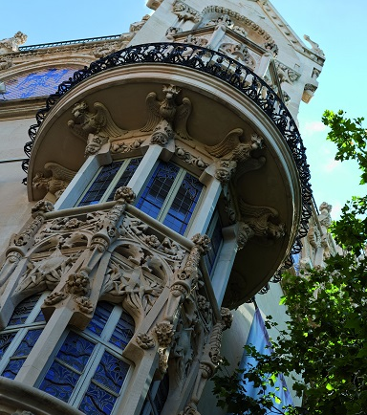
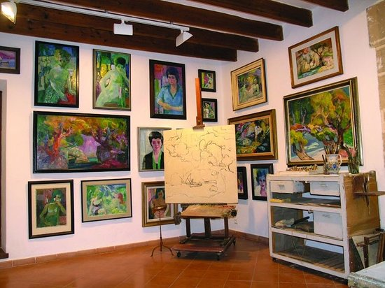
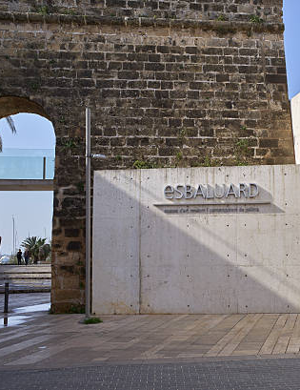
Museums
Have a taste of art in our museums and galleries:
Es Baluard
Fundació Pilar & Joan Miró
CaixaForum
Sa Bassa Blanca (Alcúdia)
Casa Museu Dionís Bennàssar (Pollença)

Slide 12
Much more to explore…
Palma and the island of Mallorca host a variety of organized routes, including literary journeys, modernism explorations, tours to Palma’s Jewish quarter, and more.

Slide 13
Tentative schedule
Abstracts | Satellite Workshop | PaPE 2025 conference
- Abstract submission deadline: 12 November 2024 - Notification of acceptance: 11 February 2025 | - Deadline for proposals: 6 October 2024 | - 25-27 June 2025

Slide 14
Mallorcans have a reputation…
I can also be stressed buddy!
…for their relaxed way of life and never being stressed, but this is NOT true because…
schwa can also be stressed in Mallorcan Catalan

Slide 15
PaPE 2025: The journey has just begun…

